Slide 1

NASA-MSFC Measurement of Cryogenic Propellant Fuel Levels
Team 516
1

Slide 2


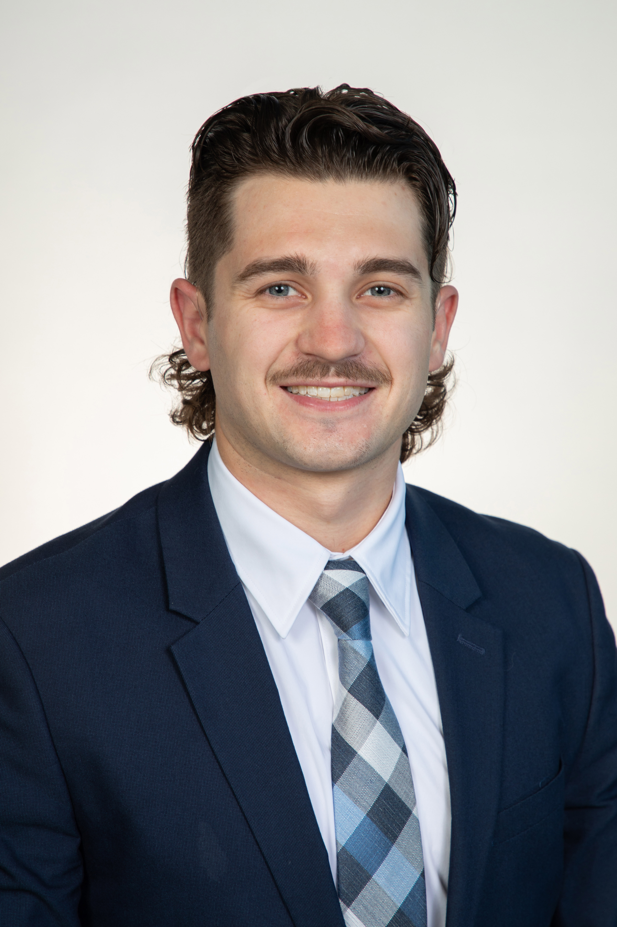
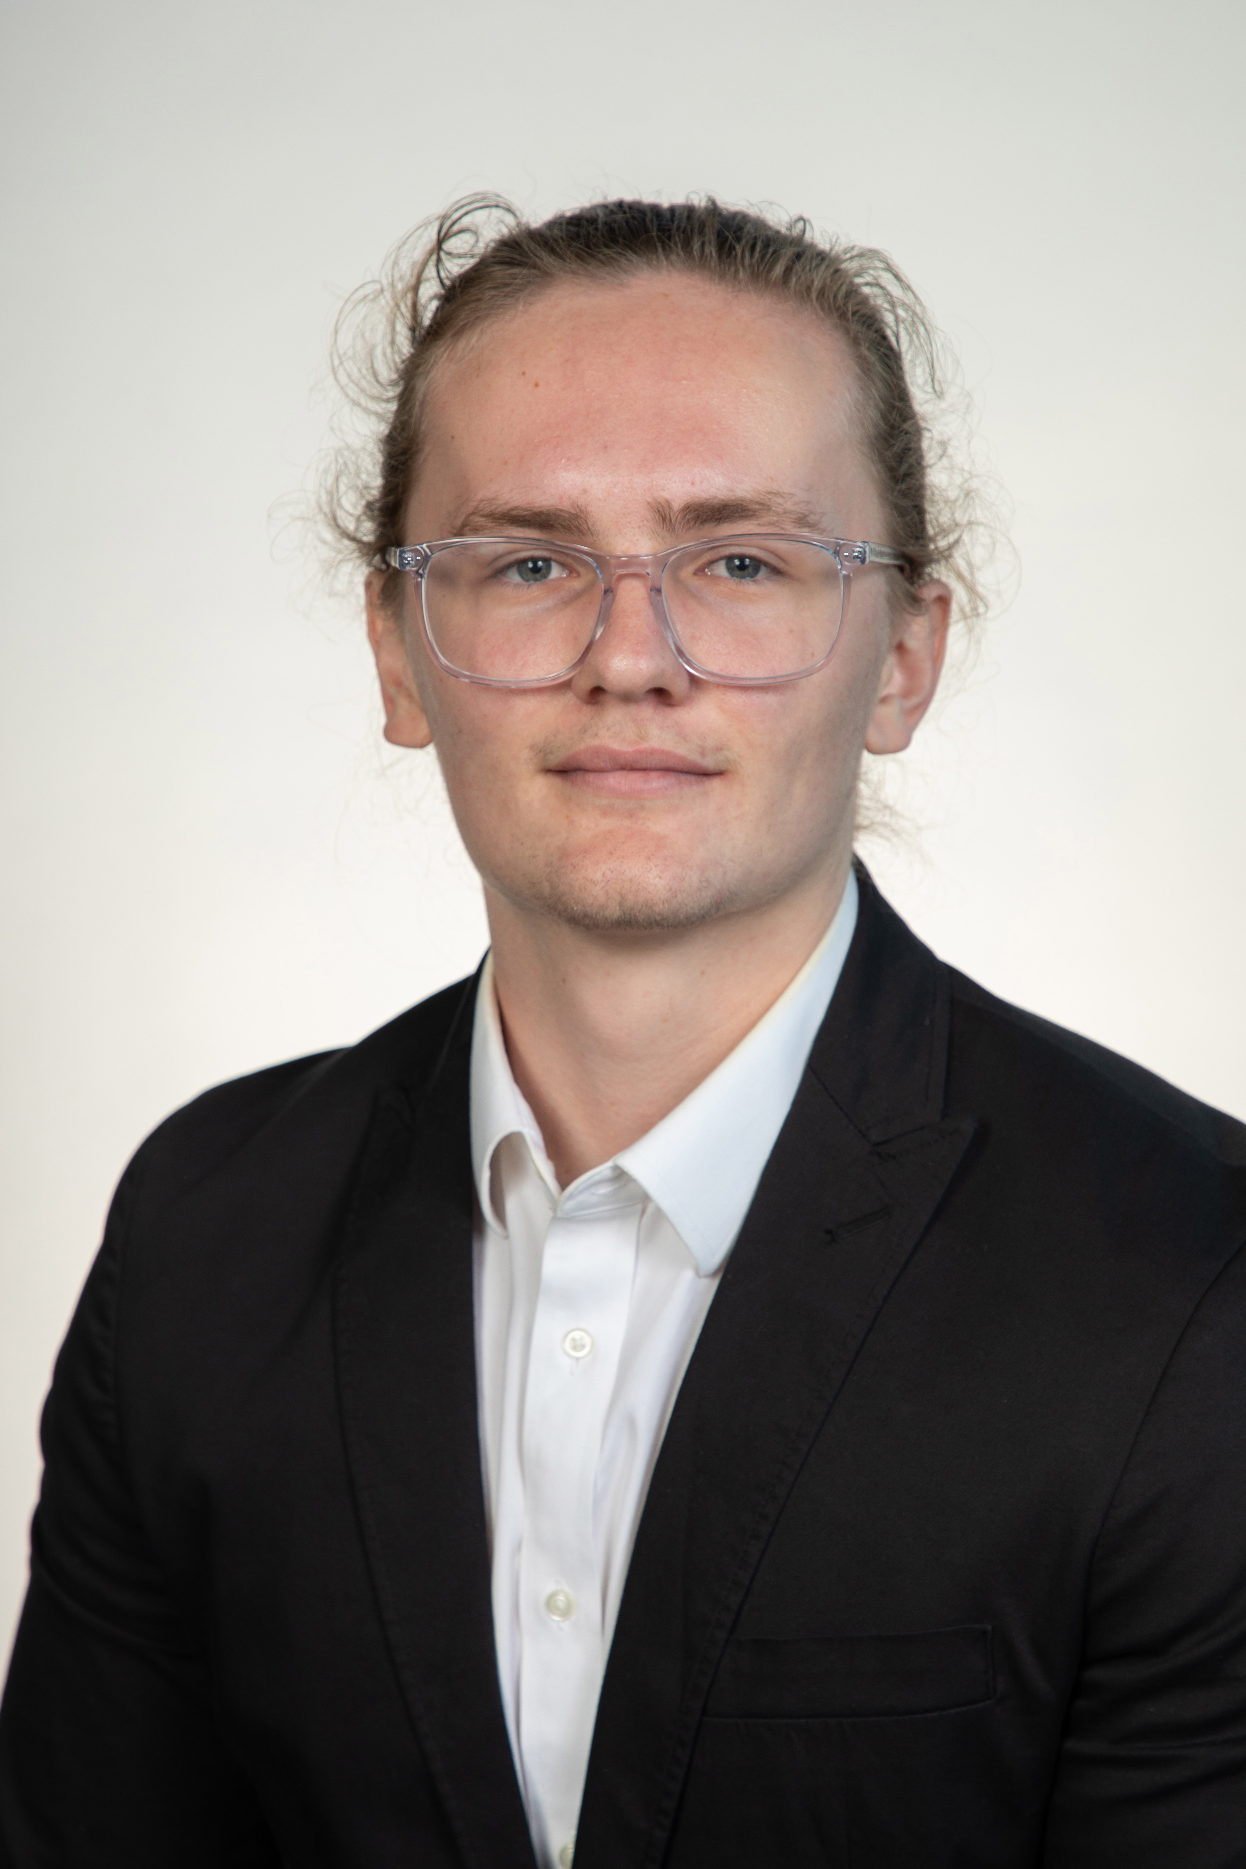
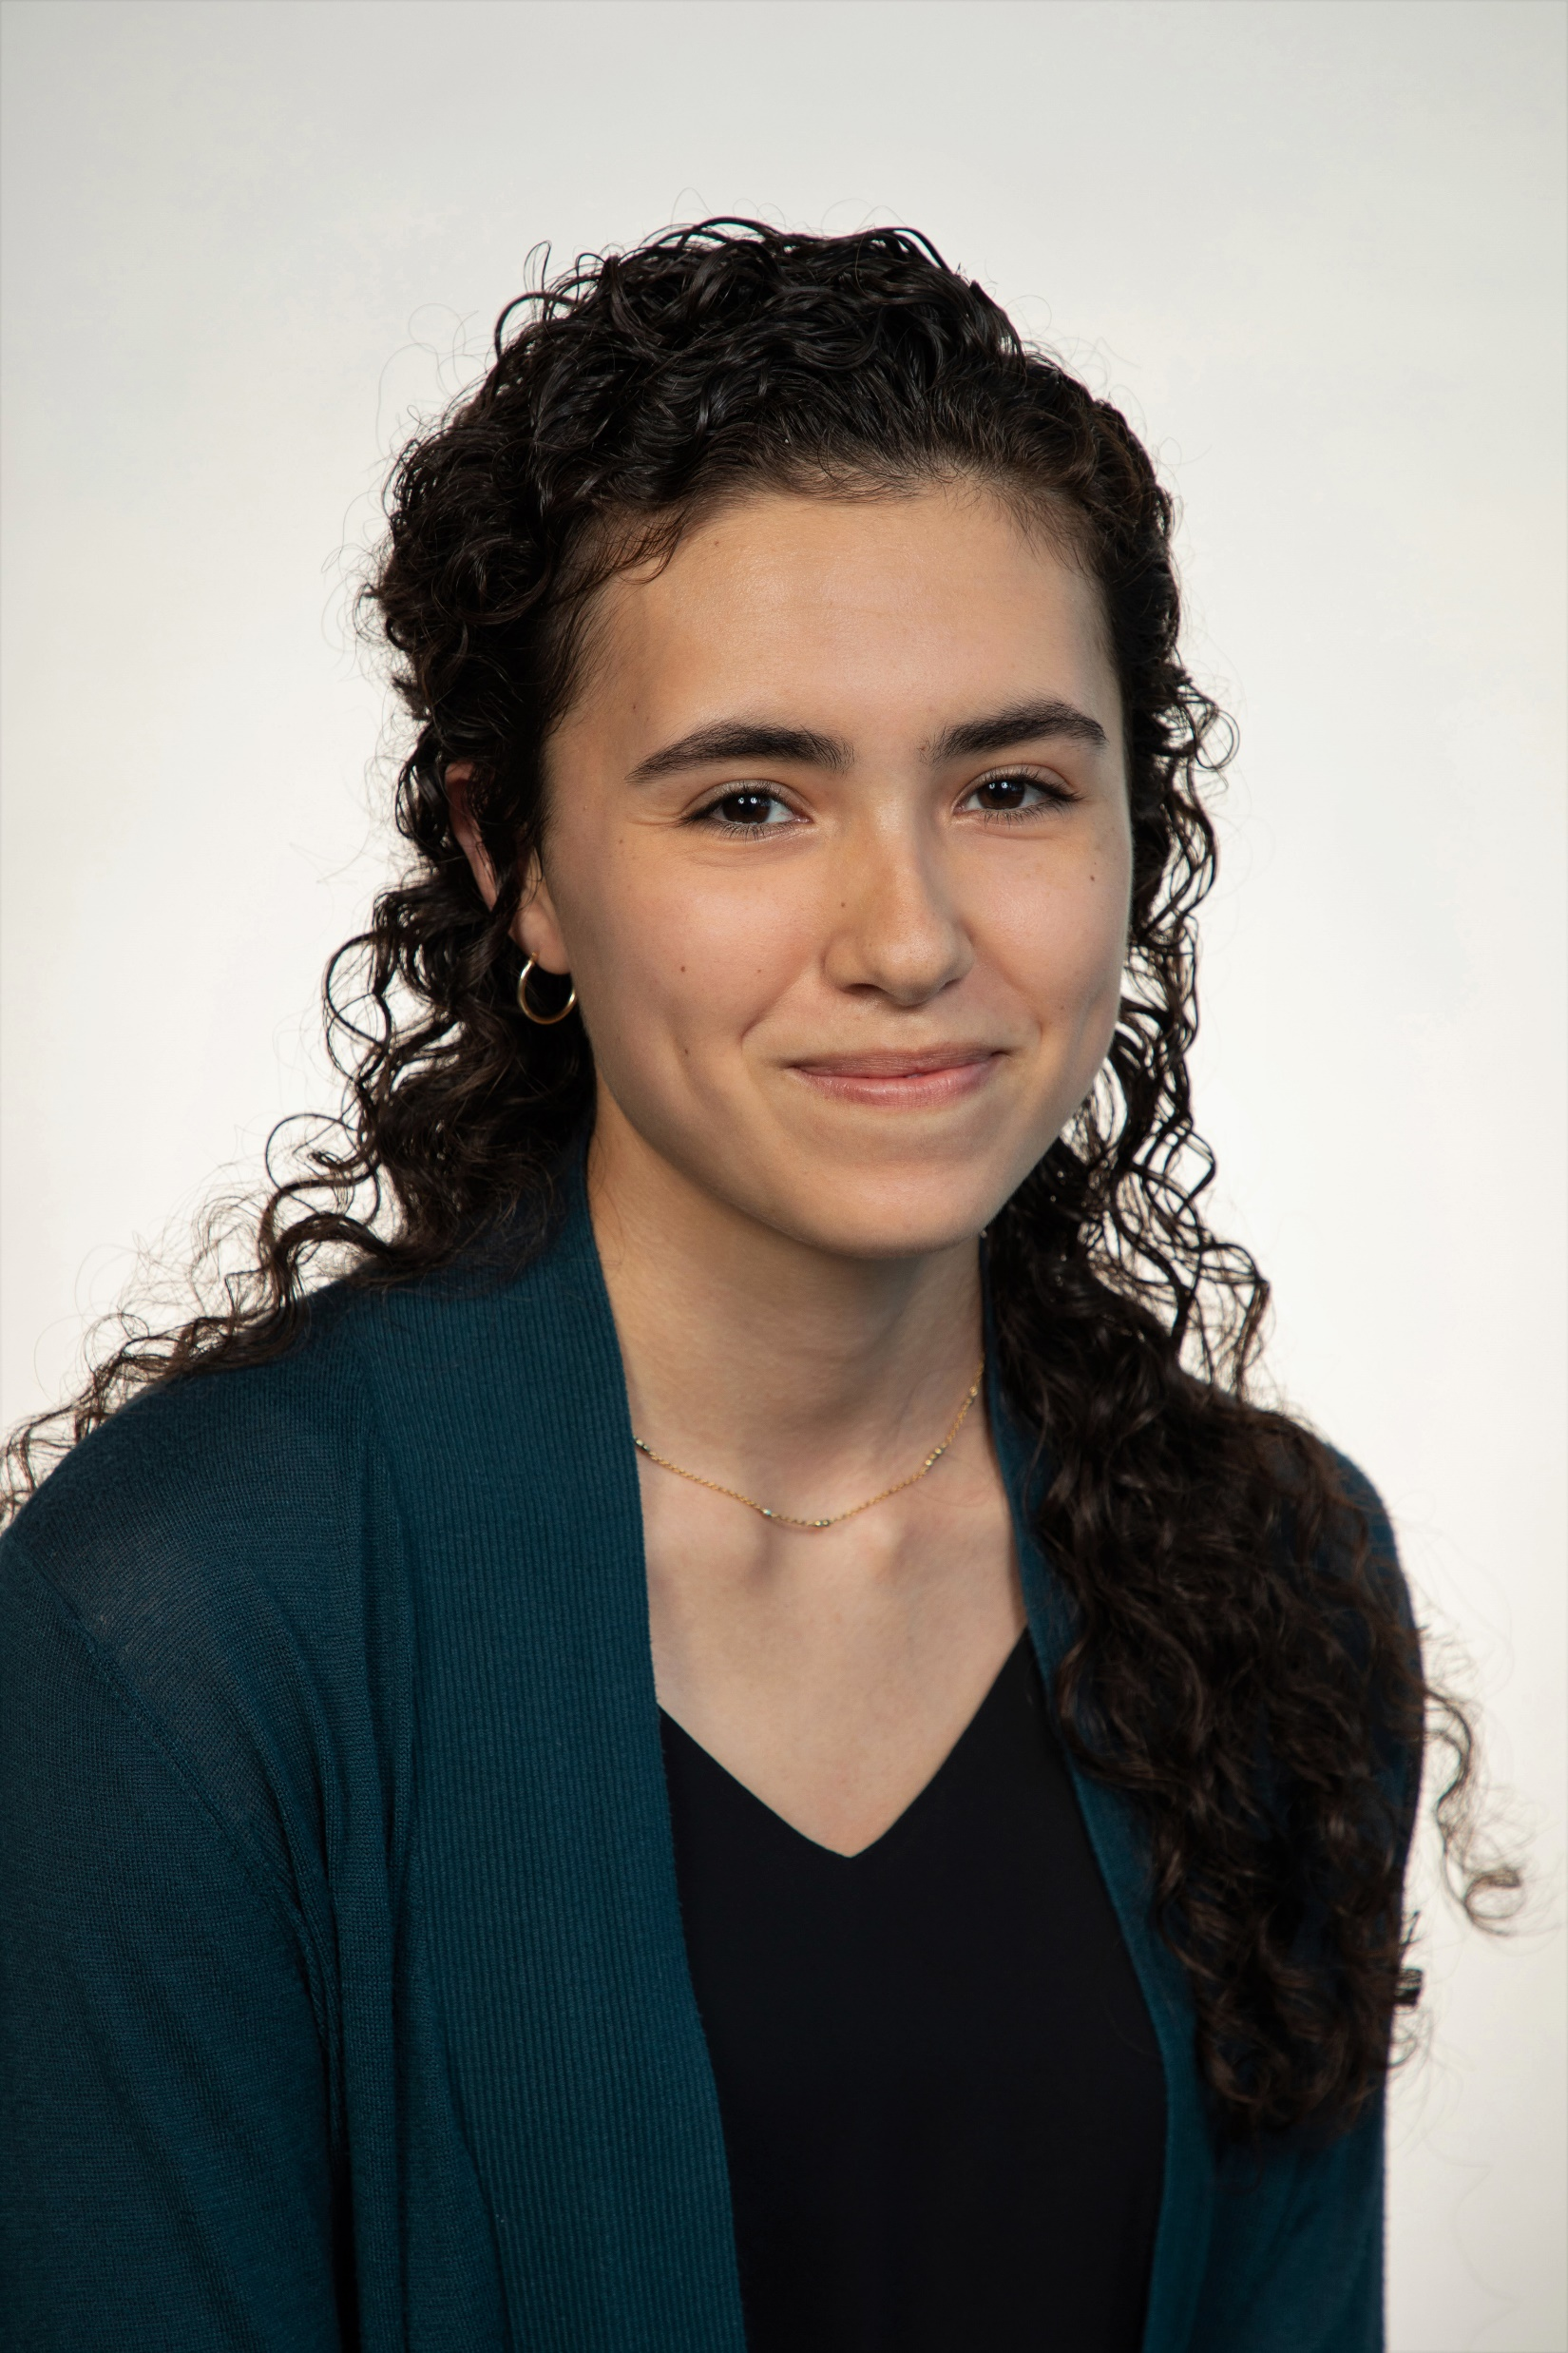
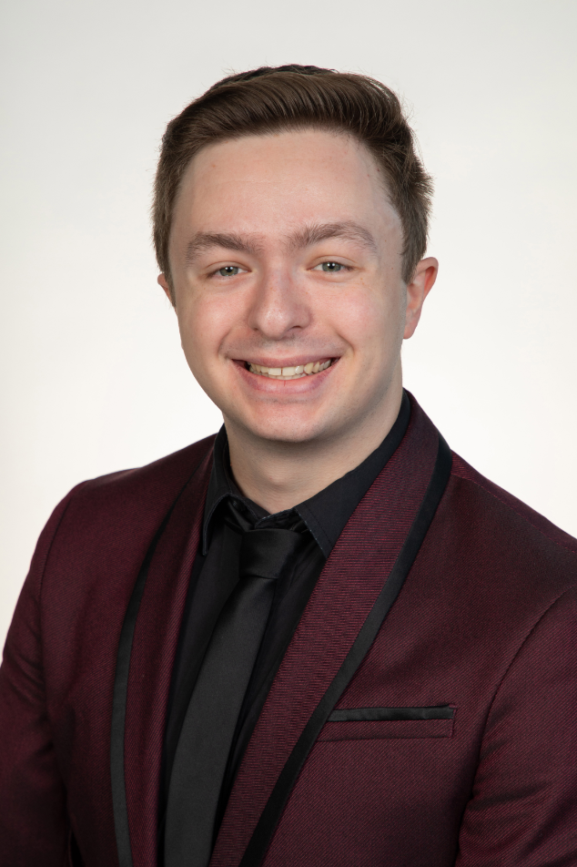
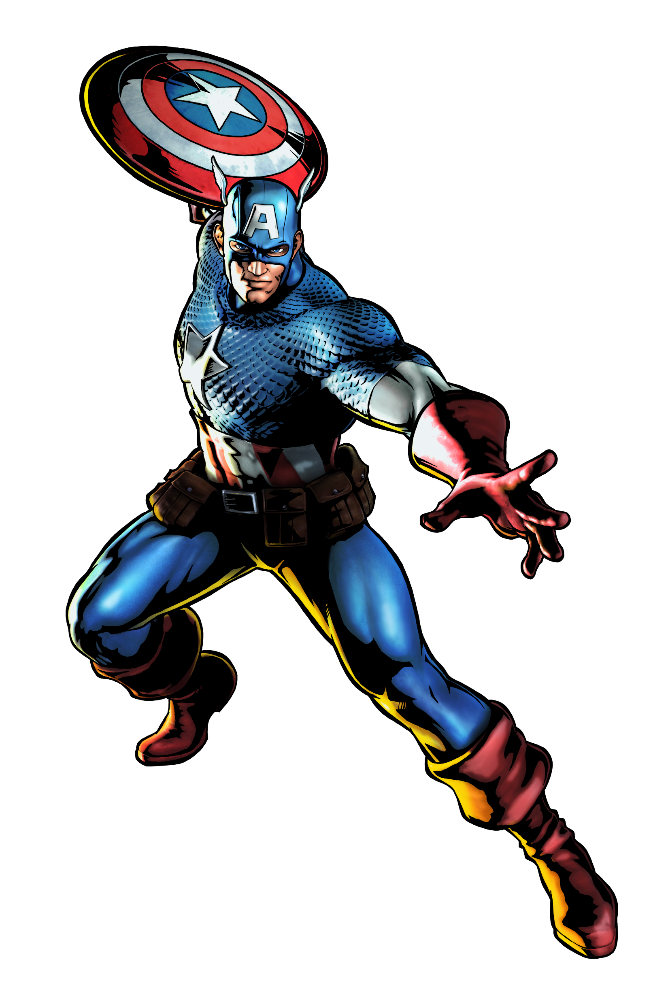
Team Introductions
Team Introductions
Zafer Jesri
Systems Engineer
Trevor Lay
Thermal Engineer
Bryson Peters
Fluids Engineer
Catherine Potts
Manufacturing Engineer
Dane Seal
Design Engineer
Bryson Peters

Slide 3
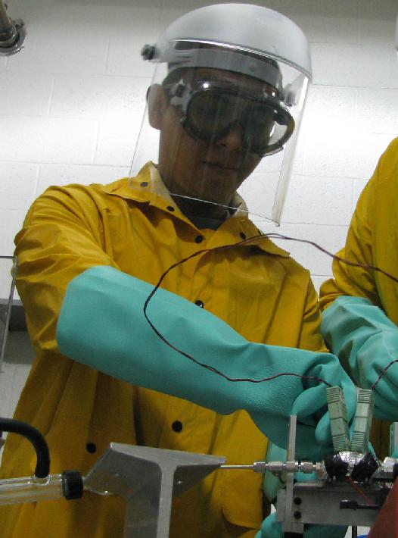
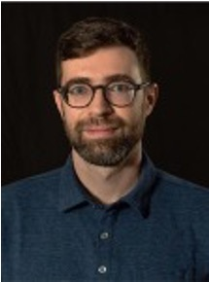
Sponsor and Advisor
Sponsor
National Aeronautics and Space Association
(NASA)
Engineering Mentor
Juan Valenzuela
Aerospace Engineer
Academic Advisor
Mark Vanderlaan, Ph.D.
Head of Hybrid and Cryogenics Operations
Bryson Peters

Slide 4
Project Objective
Create a support structure for a fiberoptic cable to measure cryogenic propellant levels in space.
Bryson Peters
4

Slide 5
Background: Cryogenic Behavior in Space
Boil-off
Liquid Fuel
Storage Tank
Bryson Peters
5

Slide 6
Background: Cryogenic Behavior in Space
Gas forms a thin layer along inside wall.
Bryson Peters

Slide 7
Background: Cryogenic Behavior in Space
Gas bubbles congregate in center of tank.
Bryson Peters

Slide 8
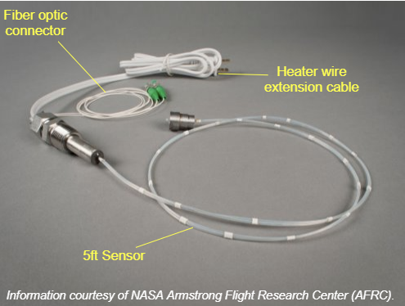
Background: Fiber Optic Sensing System
Bragg sensors read the strain on the fiber optic cable
Strain varies with temperature
The cable is connected to information system to relay data
Bryson Peters
8

Slide 9
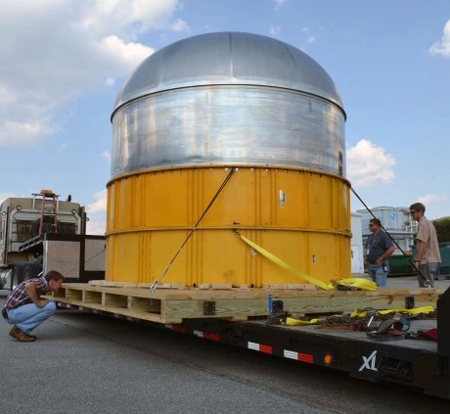
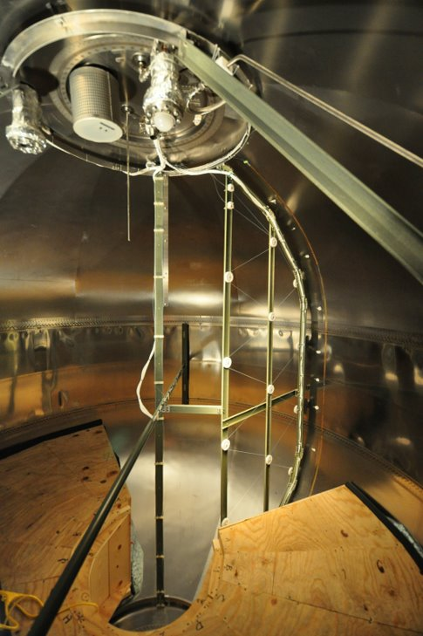
Background: Previous Designs
Bryson Peters
9

Slide 10
Background: Previous Designs
The cable would snap from stress concentration.
Pulleys were used to guide the cable through the tank.
Bryson Peters
10

Slide 11
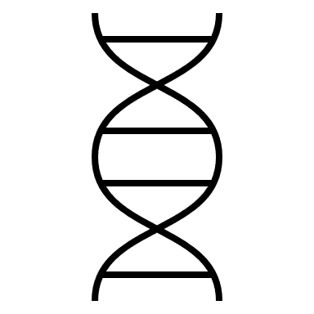
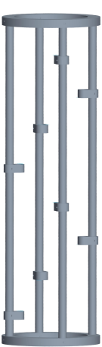

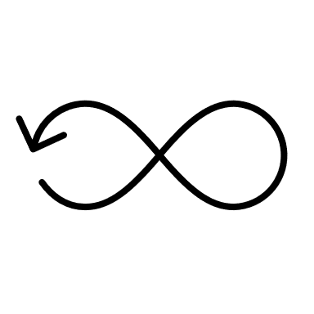

Background: Previous Designs
Helical shape for the cable
Rings hold cable with
minimal strain
Structure allowed for
twisting
No depth into center
of tank
Design by Team 514 (2021)
Bryson Peters
11

Slide 12
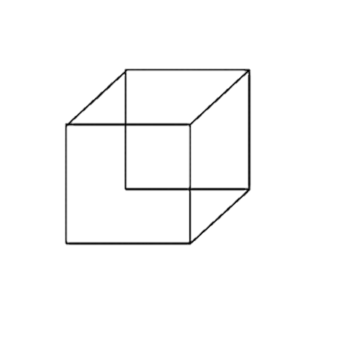




Customer Needs
Scalable Geometry
No Breakage at Cryogenic Temperatures
Measures Fuel Levels
Interpret Sensor Readings
Bryson Peters
12

Slide 13
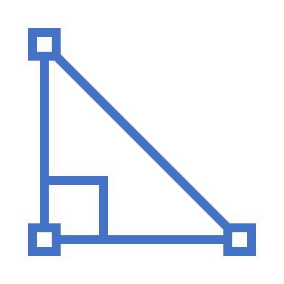


Design Specifications
Design can be scaled to operate in tank of 17 m³ (~600 ft³)
No taller than
18 in
Base is no wider than 12 in
Bryson Peters
13

Slide 14

High Fidelity Concepts
Concentric Helical Sweep Concept
Triangular Truss Concept
Honeycomb Support Concept
Bryson Peters
14

Slide 15

Concept Selection
Concentric Helical Sweep Concept
Triangular Truss Concept
Honeycomb Support Concept
Bryson Peters
15

Slide 16
Concept Selection
Binary
Pairwise
Comparison
House
Of
Quality
Analytical Hierarchy Process
Pugh
Chart
Final
Selection
Concentric Helical Sweep Concept
Triangular Truss Concept
Honeycomb Support Concept
Bryson Peters
16

Slide 17
Concept Selection
Concentric Helical Sweep Concept
Concentric Helical Sweep Concept
Triangular Truss Concept
Honeycomb Support Concept
Bryson Peters
17

Slide 18
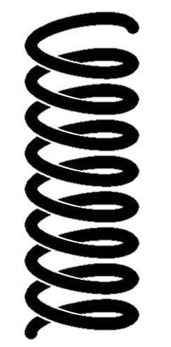






Final Selection
Nested helical sweeps of the cable
Attaching the support system to the dewar
Located in the center of the tank
Complications with open-dewar testing
Increased structural stability
Ensuring proper measurements are taken
Bryson Peters
18

Slide 19
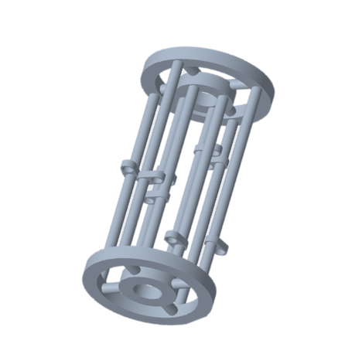
CAD Prototype
Inner Support Rings
Outer Support Rings
Connector Rods
FOSS Hooks
Stabilizing Rods
Trevor Lay
19

Slide 20

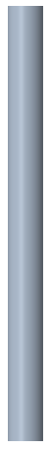



CAD Parts
ϴ = 12 in
ϴ = 10 in
Thickness = 1 in
ϴ = 1 in
3 in
12 in
1.5 in
Thickness = 1 in
2 in
ϴ = 8 in
ϴ = 6 in
1 in
1 in
Trevor Lay
20

Slide 21


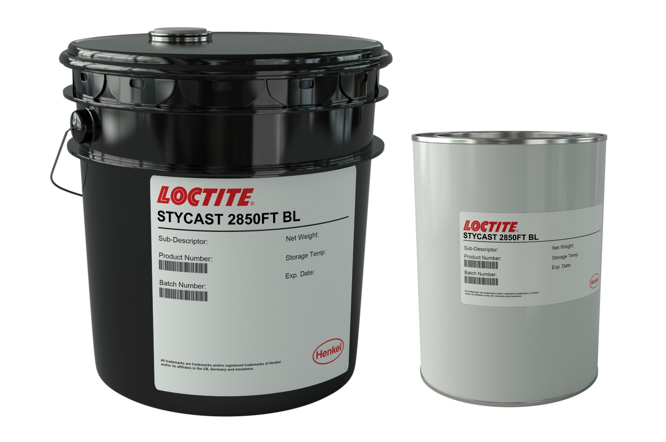
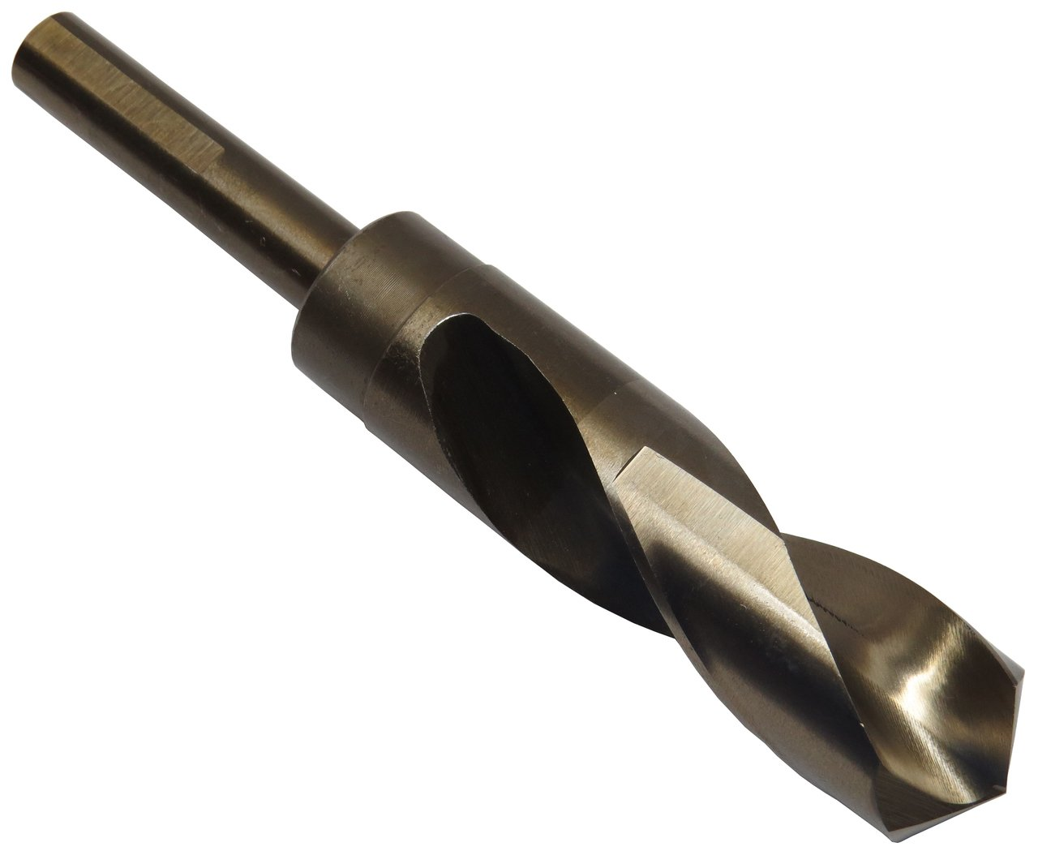
Necessary Steps
G-10 has been ordered through Fastenal
Vacuum sealing to be done at the MagLab
Special machining tools need to be ordered
Trevor Lay
21

Slide 22
Machining
ASE machine shop
Eight support rods from two 4ft rods
Eight connecting rods from one 2ft rod
Support rings from G-10 sheets
Trevor Lay
22

Slide 23
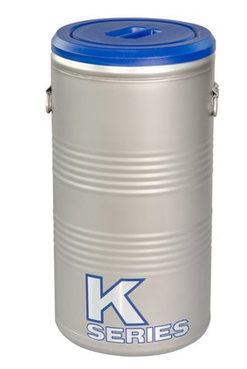
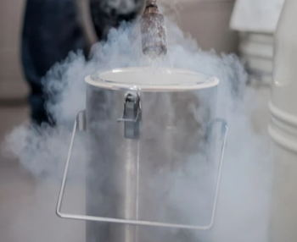

Dewar
Dimension constraints: 14 in x 19 in
Provided by MagLab
Liquid nitrogen will be provided
Dane Seal
23

Slide 24

Testing Procedure: Mass Gauging
Place dewar on scale for weight readings
Fill dewar with liquid nitrogen
(~20 ${ft}^{3}$)
Read FOSS sensors and scale readings to check accuracy
Remove prototype and let liquid nitrogen evaporate
Lower prototype into dewar
Dane Seal
24

Slide 25

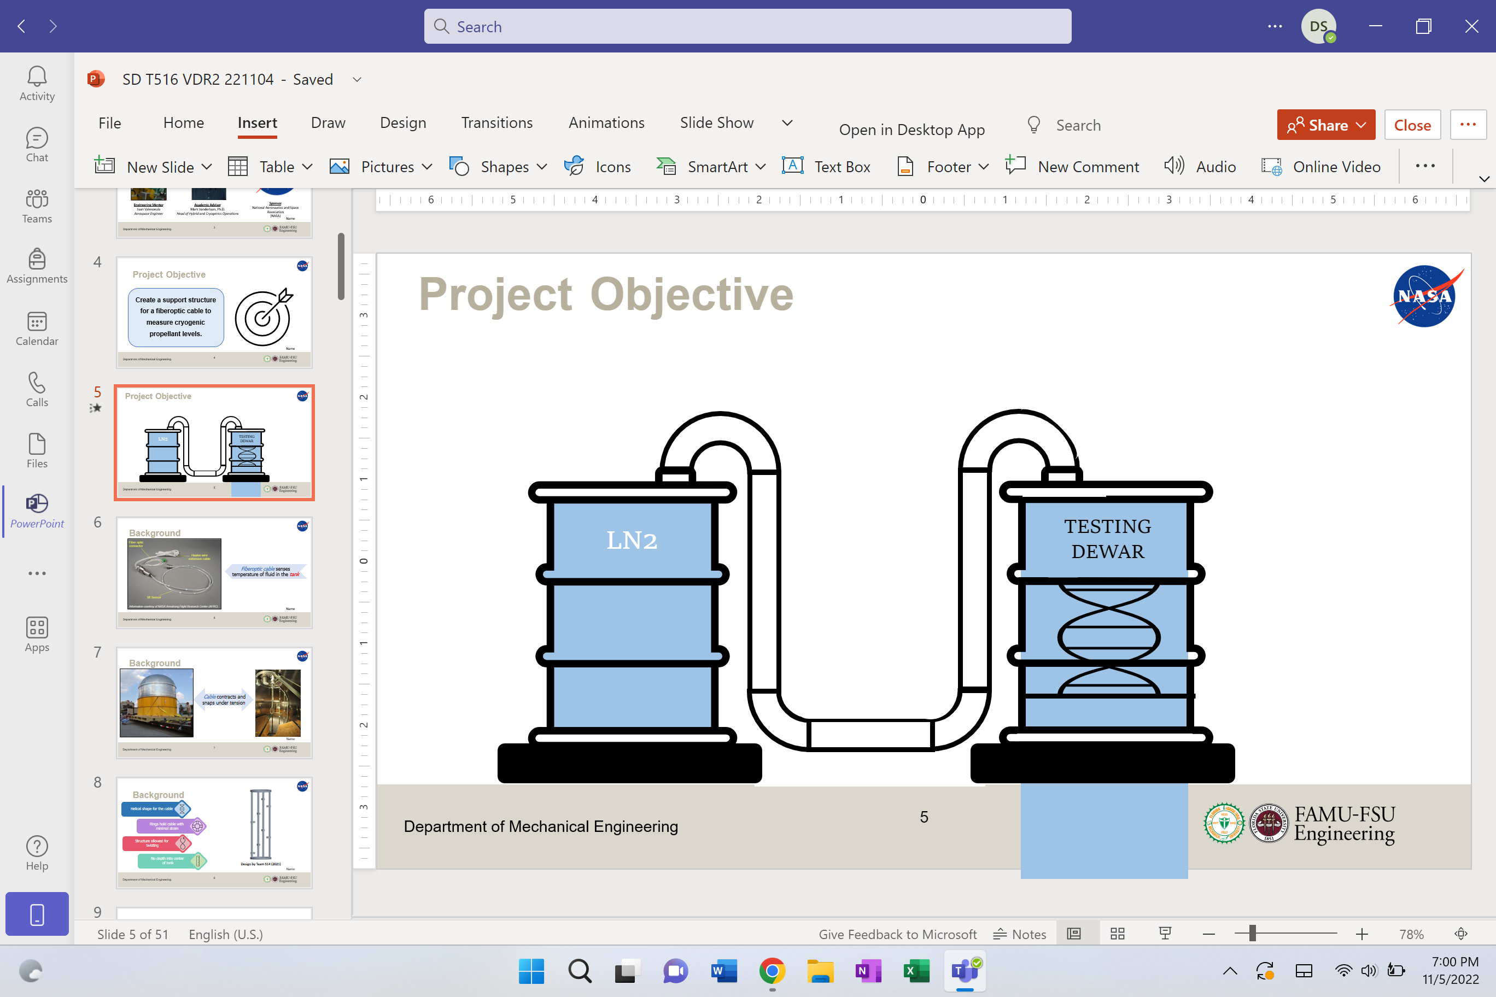
Testing Procedure
LN2
TESTING DEWAR
Temp = 77 K

Slide 26
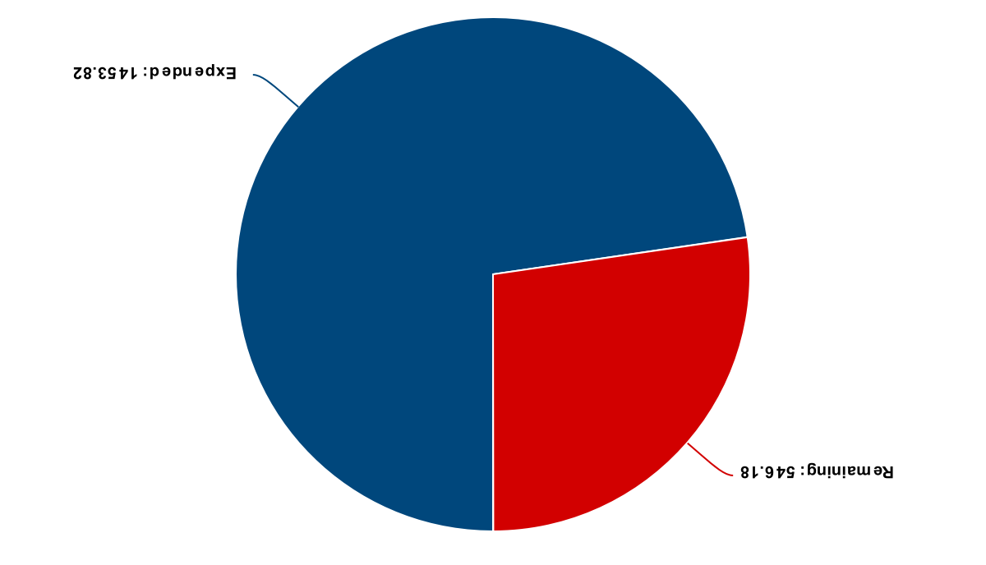
Budget
Total: $2,000
Expended:
G-10 for Prototype
Shipping
$1453.82
$546.18
Remaining:
Epoxy
Machining Tools
Dane Seal

Slide 27
Current Work
Verify testing procedure
Visit NASA to receive feedback
Create CAD drawings for machine shop
Update website to illustrate
design and progress
Dane Seal
27

Slide 28





Future Work
​Prototype Assembly
​Testing
Prototype
Analyze Results
​Final
Design
​Engineering Design Day (April 6)
Dane Seal
28

Slide 29






Summary
Dane Seal
29

Slide 30


Summary
The objective of our project is to create a support structure for a fiber optic cable to measure cryogenic
propellant levels in space
Dane Seal
30

Slide 31
Summary
In space, cryogenic boil-off congregates in the center of the tank as non-viable fuel.
Dane Seal
31

Slide 32
Summary
Our design must ensure no breakage at cryogenic temperatures. It must also be scalable and give an accurate fuel level reading
Dane Seal
32

Slide 33
Summary
Our design features a double helix support system made of G-10 that carries the FOSS through the tank.
Dane Seal
33

Slide 34
Summary
Mass Gauging: Compare the FOSS and scale readings to determine accuracy of preliminary design.
Dane Seal
34

Slide 35
Summary
Finalizing the testing procedures and assembling the prototype are the next big steps
Dane Seal
35

Slide 36




Life-Long Learning
Time Management
Communication
Flexibility
Dane Seal

Slide 37
Backup Slides

Slide 38


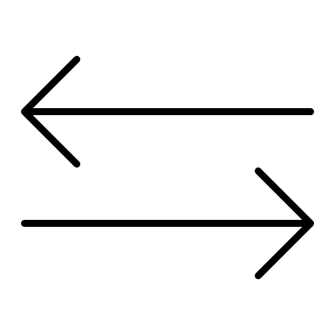
Life-Long Learning
Communication
Time Management
Flexibility
Effective communication between teammates, advisors, professors, and sponsors are paramount for project success.
Planning ahead and following a schedule allows for the project to be completed efficiently.
Ability to pivot quickly when mistakes or changes occur in the project or group.
38

Slide 39

Project Objective
Create a support structure for a fiberoptic cable to measure cryogenic propellant levels in space.
Bryson Peters

Slide 40
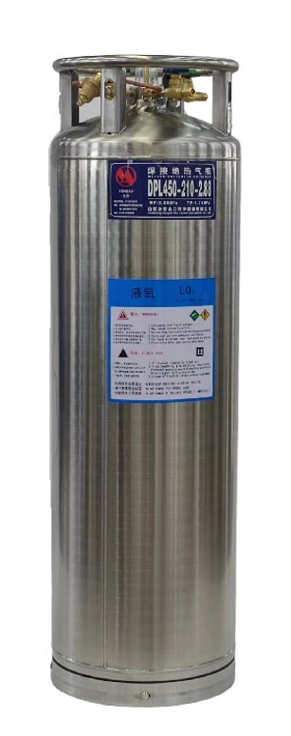
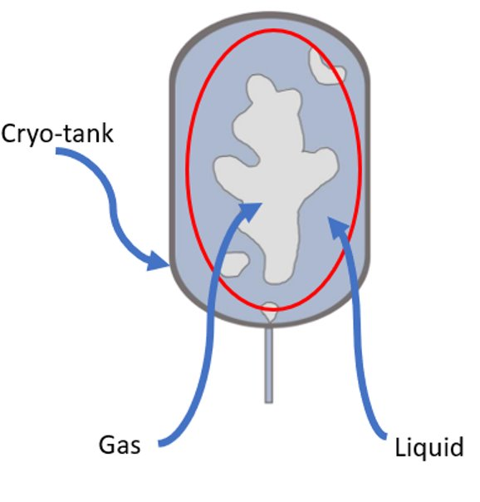
Assumptions
Testing will occur at the MAGLAB
Project Scope
Utilizing a dewar with liquid Nitrogen cryogenic testing fuel
Our structure will operate under zero-gravity conditions
The FOSS software is accurate and functional
Catherine Potts
40

Slide 41
Functional Decomposition
Sensors
Structure
Power Source
Display Interface and Code
Presenter Name
41

Slide 42






Targets and Metrics
We must ensure that the stress and strain incurred by the material at 77 K is not more than the material bounds.
The critical target for the display aspect is ensuring that our values are presented in a recognizable and presentable manner.
Sensors
The critical target dealing with the measurement system is the prevention of snapping or fracturing while exposed to LN2.
Display
POWER
Structure
Power source
supplies at least 12V​
Bryson Peters
42
Notes:
Target max stress and strain values for glass: 1KN/area, 3.5% strain

Slide 43






Concept Generation
Brainstorm
Crap Shoot
Biomimicry
S.C.A.M.P.E.R.
Catherine Potts
43

Slide 44
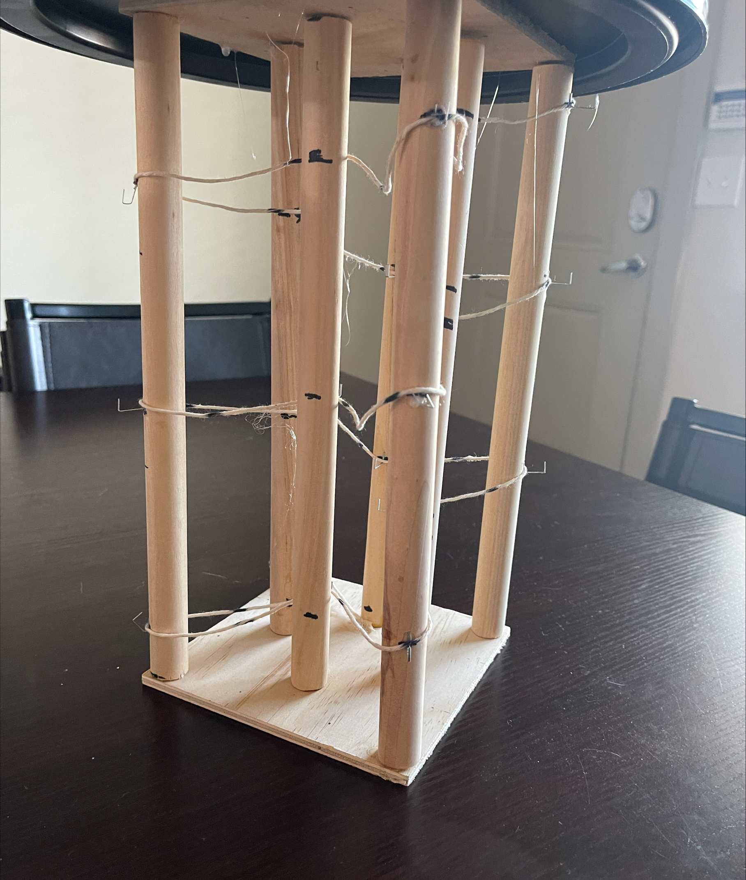
VDR3 Prototype
Made to represent our concept visually
Constructed using wooden dowels, staples, string, and super glue
Next prototype will be made using G-10
Trevor Lay
44

Slide 45


Design Challenges
Machining
(drill bits and material)
Dewar dimensions and constraints
Altering design to better fit FOSS cable
Zafer Jesri

Slide 46



MagLab Safety Training
Cryogenic
Safety
Electrical
Safety
Hazard
Communication
Magnetic Field Safety
Zafer Jesri

Slide 47
Functional Decomp Backup

Slide 48

​February 28
​March 6
​March 10
​April 1
​April 6
NASA MSFC Feedback
​Prototype Assembly
​Testing
Prototype
​Final
Design
​Engineering Design Day
​Use the feedback provided from the trip to construct the best testing and assembly procedure.
​Order parts through certified vendors. Machine materials and parts to proper sizing. Assemble a testable prototype.
​Transfer prototype to MagLab for testing. Test the structure and FOSS system using test procedure discussed in Risk Assessment.
​Develop final prototype based off initial results from testing. Test the new prototype to confirm optimal design.
​Present final design to NASA and other colleagues at the Engineering Design Day Fair.

Slide 49
Concept Selection Backup

Slide 50
Detailed Math Backup

Slide 51
Standard Shapes
Summary Box
Text box 1
Outlined Text Box

Slide 52
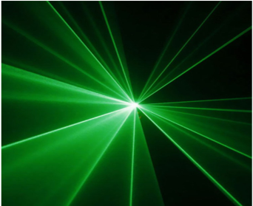
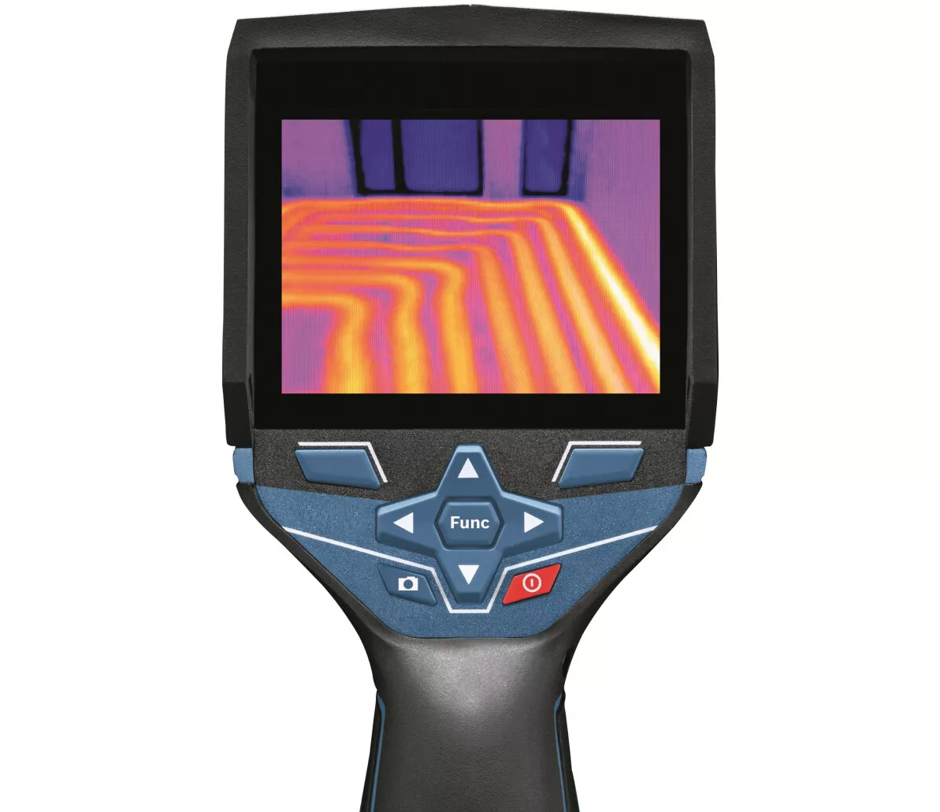

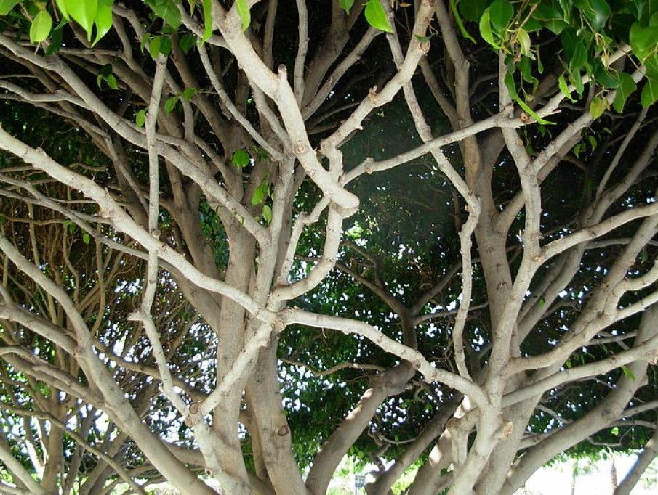
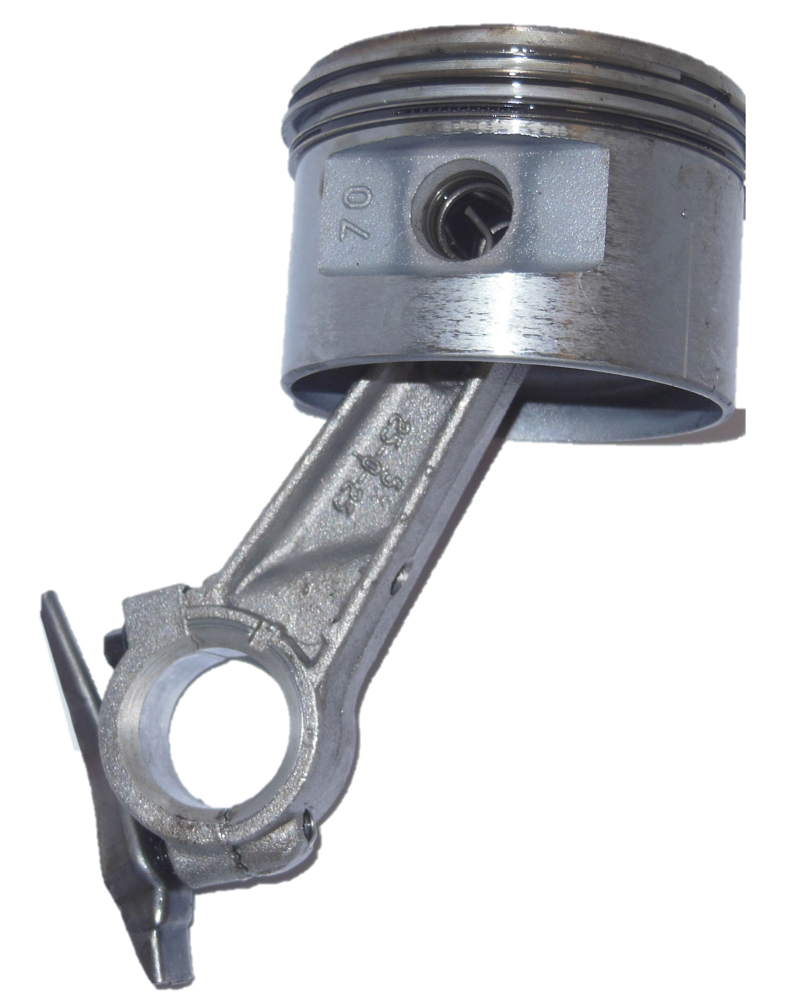
Do we still want this slide? Or nah
Name
52

Slide 53


Cool Shapes
Cable
Support Structure
Top View

Slide 54

NASA-MSFC Measurement of Cryogenic Propellant Fuel Levels
Team 516
54

Slide 55

NASA-MSFC Measurement of Cryogenic Propellant Fuel Levels​
Team 516
55

Slide 56




Approved Logos

Slide 57
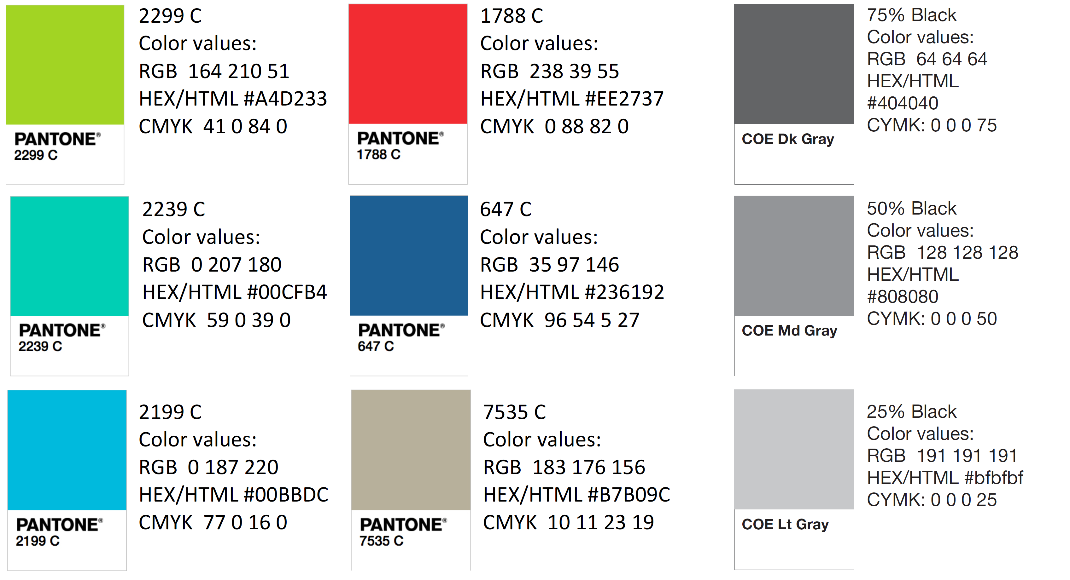
Color Palette

Slide 58
APA Tables
Category 1 | Category 2 | Category 3 | Category 4 | Category 5
Item 1
Item 2
Item 3
Item 4
 | Category 2 |  |  | Category 3
Category 1 | subcategory 1 | subcategory 2 |  | subcategory 1 | subcategory 2
Item 1
Item 2
Item 3
Item 4

